Slide 1

HAND GESTURE RECOGNITION
Presented by
G. Nandini - AP21110010912
Krishna Sharma - AP21110010914
C Sai Kumar - AP21110010943
D. Srinadh - AP21110010951

Slide 2
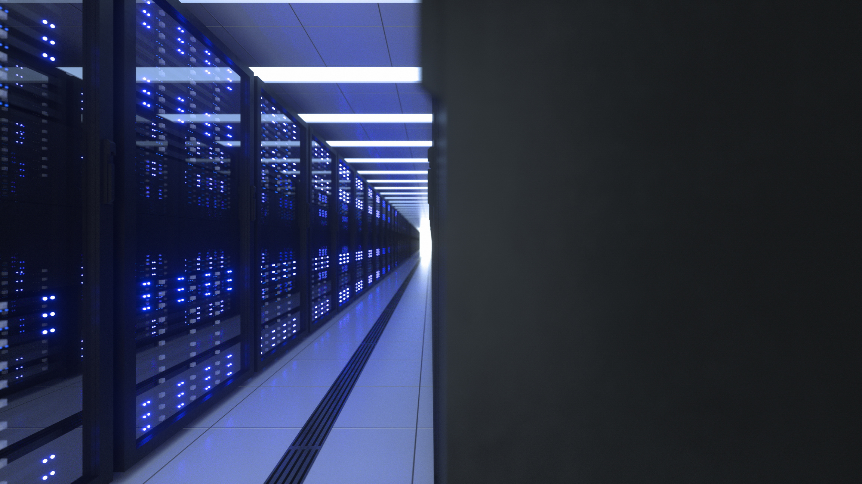
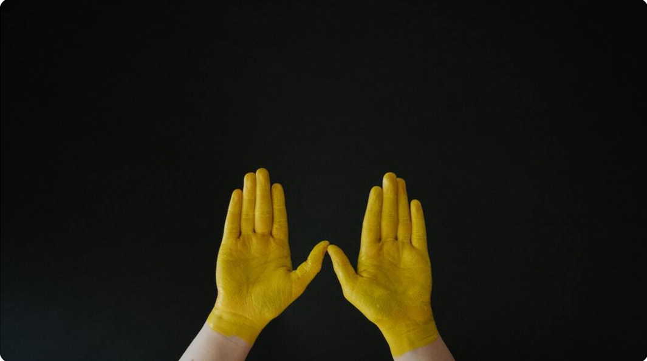
PROBLEM STATEMENT
Design and implement a hand gesture recognition system for American Sign Language using CNN and fuzzy logic to manage gesture data's uncertainty, variability, and ambiguity. The system will use fuzzy sets and rules to classify gestures based on features such as hand shape, finger positions, and motion trajectories, enabling accurate and interpretable recognition in real-world environments."
Scope:
The system will focus on recognizing static gestures (e.g., alphabet signs) and basic dynamic gestures.
Input will be obtained using a camera or hand-tracking device.
Outputs will be classified as ASL symbols with associated confidence levels, which can be converted to text or audio for non-ASL users.

Slide 3
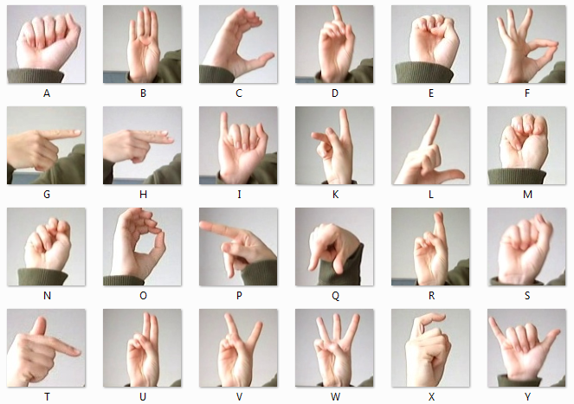
DATA SET
For this project, we used the MNIST SIGN Dataset, widely recognized for its comprehensive collection of static hand gesture images representing the 25 letters of the American Sign Language alphabet. The dataset is sourced from Kaggle, containing over 34,627 images of gestures captured under controlled conditions.
Features:
Includes hand gesture images labeled from A to Z.
Covers variations in hand positions and orientations.
Provides data suitable for training and testing models on static ASL alphabet recognition.

Slide 4
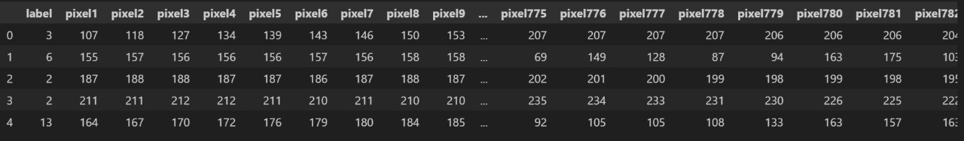
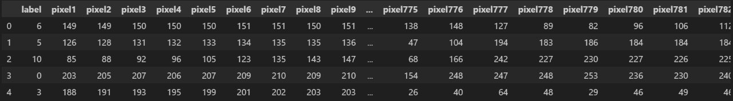
SAMPLE OF TRAIN AND TEST DATA

Slide 5

MODEL ARCHITECTURE
CNN Layers:
Multiple convolutional and max-pooling layers for feature extraction.
Dropout layers to prevent overfitting.
Fuzzy Logic in Gesture Recognition:
FIS: Classifies gestures using fuzzy rules.
Membership Functions: Maps features (e.g., shape, orientation) to fuzzy values.
Defuzzification: Converts fuzzy outputs into precise gesture classifications.
Use in Project:
Fuzzy logic helps handle uncertainties and imprecise inputs, improving gesture classification in complex scenarios.

Slide 6
CNN ARCHITECTURE FOR HAND GESTURE RECOGNITION
1. INPUT LAYER: ACCEPTS GRAYSCALE IMAGES OF SIZE 28X28X1.
2. CONVOLUTIONAL LAYERS:
- CONV2D LAYERS: EXTRACT FEATURES USING 32, 64, AND 128 FILTERS OF SIZE (3X3).
- RELU ACTIVATION: INTRODUCES NON-LINEARITY FOR COMPLEX PATTERN LEARNING.
3. POOLING LAYERS:
- MAXPOOLING2D: REDUCES SPATIAL DIMENSIONS BY SELECTING THE MAXIMUM VALUE IN 2X2 WINDOWS, PRESERVING IMPORTANT FEATURES.
4. DROPOUT: RANDOMLY DROPS NEURONS (25%) TO PREVENT OVERFITTING.
5. FLATTEN LAYER: CONVERTS THE 2D FEATURE MAPS INTO A 1D VECTOR FOR DENSE LAYERS.
6. DENSE LAYERS:
- FULLY CONNECTED LAYER WITH 512 NEURONS (RELU ACTIVATION) LEARNS HIGH-LEVEL PATTERNS.
- OUTPUT LAYER WITH 25 NEURONS (SOFTMAX ACTIVATION) PREDICTS ONE OF 25 CLASSES (A-Y).
7. OPTIMIZER & LOSS FUNCTION:
- ADAM OPTIMIZER: EFFICIENTLY UPDATES WEIGHTS.
- CATEGORICAL CROSSENTROPY: CALCULATES ERROR FOR MULTI-CLASS CLASSIFICATION.

Slide 7

FUZZY LOGIC INTEGRATION FOR PREDICTION REFINEMENT
Input: Probabilities generated by the CNN for each class (A-Y).
Fuzzy Inputs: Defined for each letter with membership functions (low, high) based on CNN confidence.
Fuzzy Outputs: Confidence percentages (0-100%) for each class with membership categories (low, high).
Fuzzy Rules:
If confidence is high, then output confidence is high.
If confidence is low, then output confidence is low.
Refinement Process:
Fuzzy logic adjusts CNN probabilities for robustness and reduces uncertainty.
Outputs are normalized to ensure valid probability distribution.
Final Prediction:
Class with the highest refined probability is chosen as the result.

Slide 8
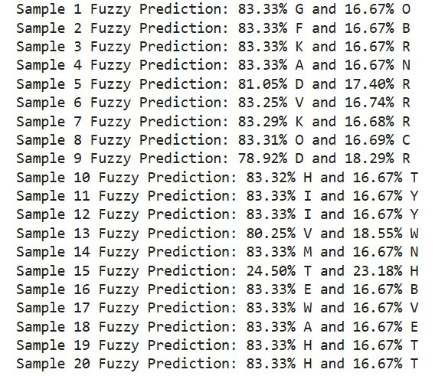

Slide 9

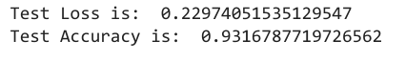
RESULTS
Performance:
Training Accuracy: 99%.
Validation Accuracy: 98%.
Test Accuracy: 93%.
Test Results:
Visualization:
The visualization of training and validation accuracy/loss over epochs should be generated.
The relatively low test loss indicates the model is confident in its predictions.

Slide 10
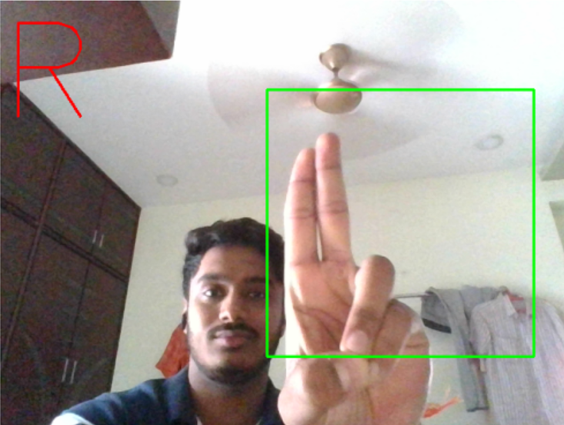
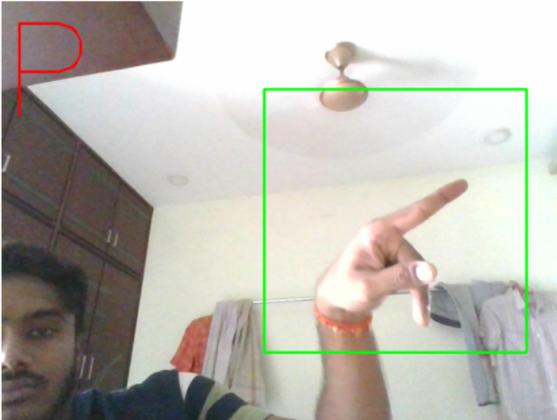
RESULTS:

Slide 11

THANK YOU

